Slide 1
TEAM NAME:- CODE BRIGADE
PROBLEM STATEMENT:- There is a need for a platform where budding startups, entrepreneurs and investors can connect. To pitch in their ideas and get a kickstart for their venture. Also, the business ventures are looking for ambitious people to join them and work on innovative ideas.

Slide 2
EI CONNECT:-
The idea proposed is to develop a real-time web based platform “Ei connect” which renders information about the idea the investors can pitch for the idea, providing the feasible amount he/she can invest for it and reason for pitching the idea.
The proposed idea will provide an online platform for the entrepreneurs who are in search of investors to connect with each other and grow their business.
The idea is basically to build and connect the entrepreneurs, investors and the budding startups to an online platform where it will be easy for the entrepreneurs to present their idea and for the the investors to pitch the entrepreneurs for their idea.

Slide 3
WORKING OF THE APPLICATION:-
The investors that are added by the admin will search for any particular idea they want or pitch for the idea from the shown list retrieved from the database along with the details of the entrepreneurs uploading that idea.
The investors will rate the idea, specify the feasible amount they can invest and give the reason for pitching that idea . The entrepreneurs can view the details of the investors as well as the pitch status of their idea and all the ideas that are uploaded till date . The entrepreneurs and the investors can contact with each other in personal through the contact details provided in their bio .
They can provide their feedback or ask any help or enquiry. All the details of the investors and entrepreneurs referring to the web application is stored in the database with necessary security.
The details of the entrepreneurs joining with this platform along with the idea description is securely stored in the database with the help of PHP.

Slide 4
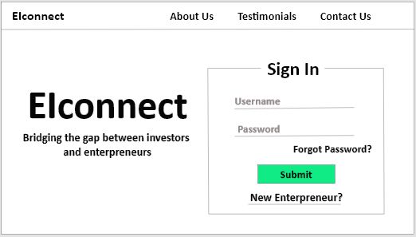
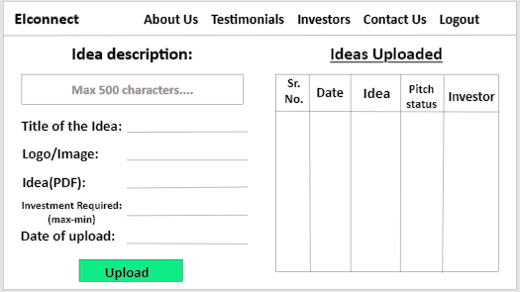
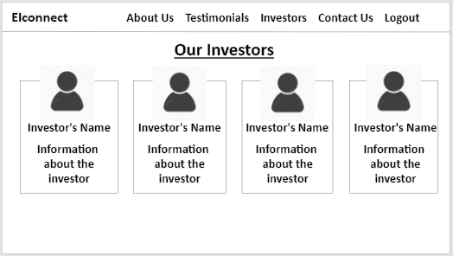
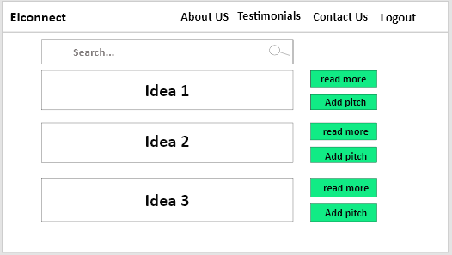
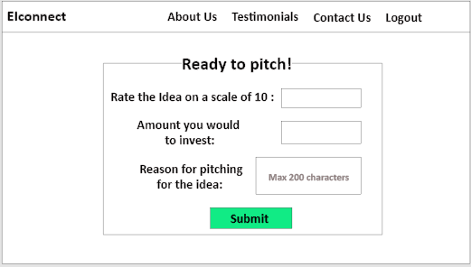
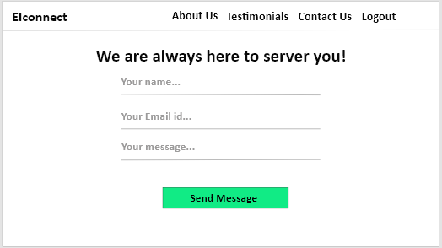
Prototype :-
When Entrepreneur Log in
When Investor Log in

Slide 5
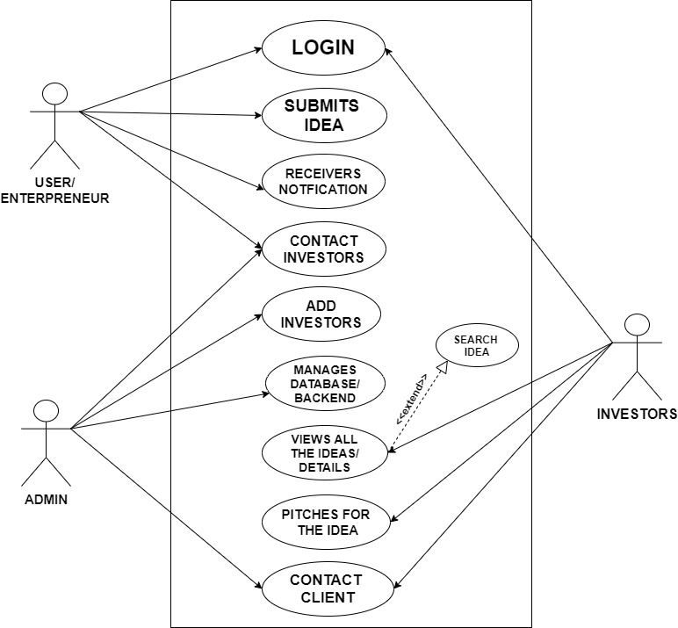
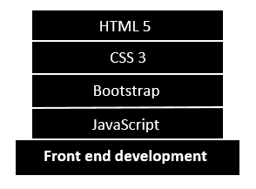
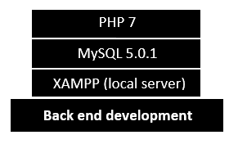
Use case :- Technology stack

Slide 6
ADVANTAGES OF OUR SOFTWARE:-
The entrepreneurs can directly interact with the investors and present their ideas without any intervention.
The details of the entrepreneurs joining with this platform along with the idea description is securely stored in the database with the help of PHP.
The investors can pitch the ideas they like and directly contact with the respective entrepreneurs.
Entrepreneurs can see the pitch status.

